Slide 1
BizPlus AI
A success response can hide
an unfinished transaction
Business assertions with approved recovery
Actual merchant Test Checkout and owned HTTPS checks
share the same public Render dashboard.
BizPlus AI 1/7
Notes:
The project leads with business assertions and bounded recovery. An HTTP 200 response can hide a missing confirmation in the owned synthetic journey. The storefront is an additional actual Razorpay Test Mode integration. Live checks make actual approved HTTPS requests. Rules remain visibly labelled; there is no live LLM. Test Mode moves no real funds.

Slide 2
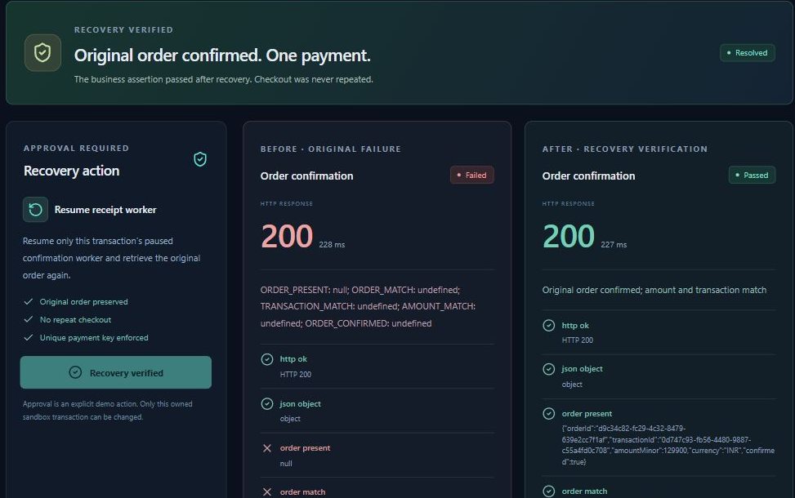
Business outcome and bounded recovery
Observed evidence | Business outcome
HTTP 200 | Order confirmation missing
One simulated payment | Original order preserved
Explicit approval | Verification before resolution
Recovery verifies the original order and keeps one simulated payment
BizPlus AI 2/7
Notes:
The native table compares transport status with business state. The screenshot comes from the current public Render browser recovery. It verified the original synthetic order d9c34c82-fc29-4c32-8479-639e2cc7f1af in 227 ms, retained one simulated payment before and after, and survived direct-route refresh. The latest separate hosted core HTTP replay passed 18 smoke checks. This synthetic worker action does not retry or remediate Razorpay payments. Existing products already offer response assertions and AI diagnosis. Sources: artifacts/verification/render-recovery-browser.json, https://docs.newrelic.com/docs/synthetics/synthetic-monitoring/scripting-monitors/write-synthetic-api-tests/ and https://www.checklyhq.com/docs/resolve/ai-root-cause-analysis/overview/ .

Slide 3
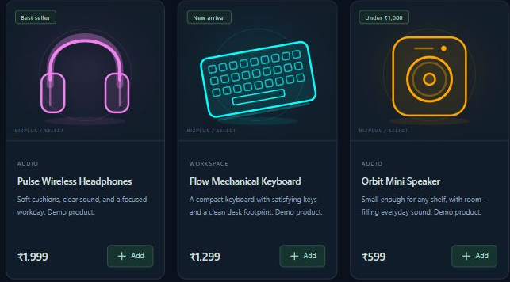
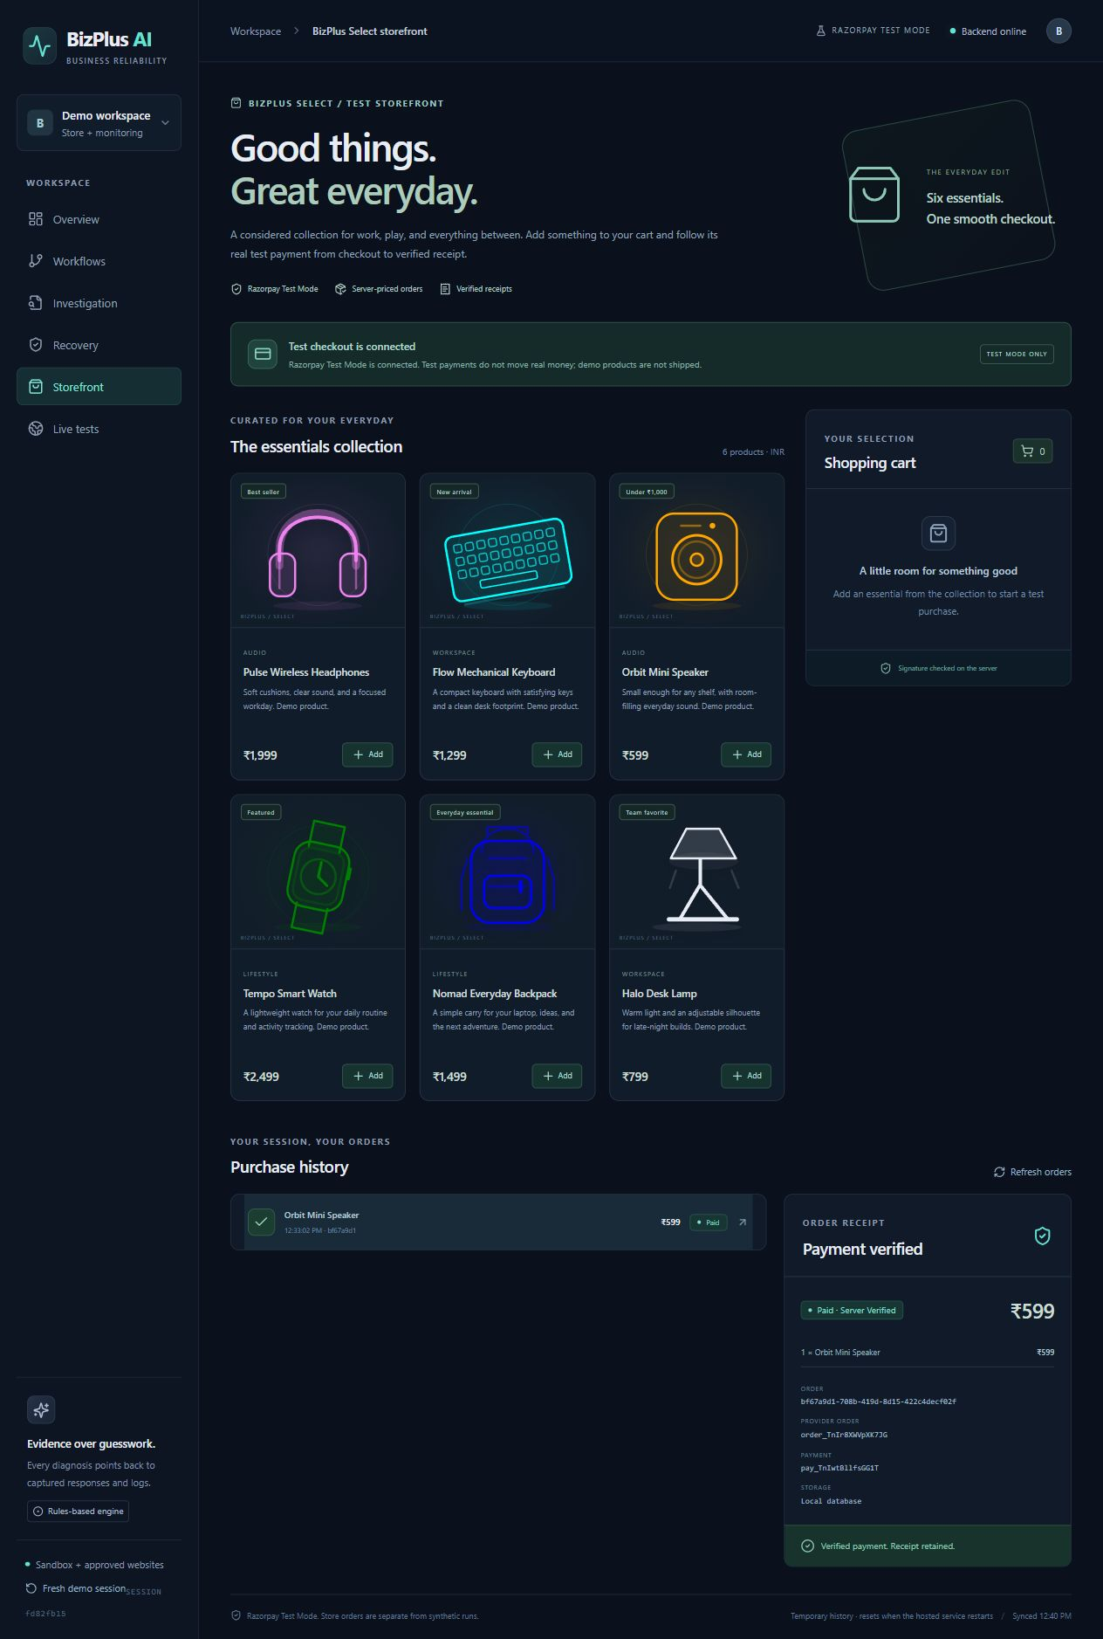
Merchant Test Mode storefront
Six server-priced products and actual provider checkout
Test Mode only. INR 599 server verified. Receipt survived refresh.
BizPlus AI 3/7
Notes:
The left crop shows the actual six-product catalog in the locally verified storefront. The right crop shows the current public Render purchase receipt. Public provider read-back confirms internal order bf67a9d1-708b-419d-8d15-422c4decf02f, provider order order_TnIr8XWVpXK7JG, and payment pay_TnIwtBllfsGG1T. The payment is captured in Test Mode for INR 599 with matching currency and provider totals. The browser cart is empty and receipt survives refresh. Test Mode moves no real funds and these demo products are not shipped. Source: artifacts/verification/razorpay-render-purchase.json. Provider integration guidance: https://razorpay.com/docs/payments/payment-gateway/web-integration/standard/integration-steps/ .

Slide 4
Render application architecture
Judge browser
Render
React and Express
Razorpay
Test API
Active SQLite
Temporary history
Optional private PostgreSQL
Local tested only
Approved HTTPS
Read-only checks
Owned synthetic
shop journey
Rules and approved
worker resume
Supabase cloud activation pending
Payment and database secrets stay on the server
BizPlus AI 4/7
Notes:
Every box and connector is editable. The React frontend and Express API run on the same Render service. Active hosted persistence is temporary SQLite. An optional private PostgreSQL primary adapter passed actual local Windows PostgreSQL tests; Supabase is not connected because activation awaits a valid PostgreSQL URI. Razorpay is Test Mode only. Live checks use a bounded server allowlist, public DNS pinning, and no browser login or credentials. Synthetic recovery operates only on the owned sandbox confirmation worker.

Slide 5
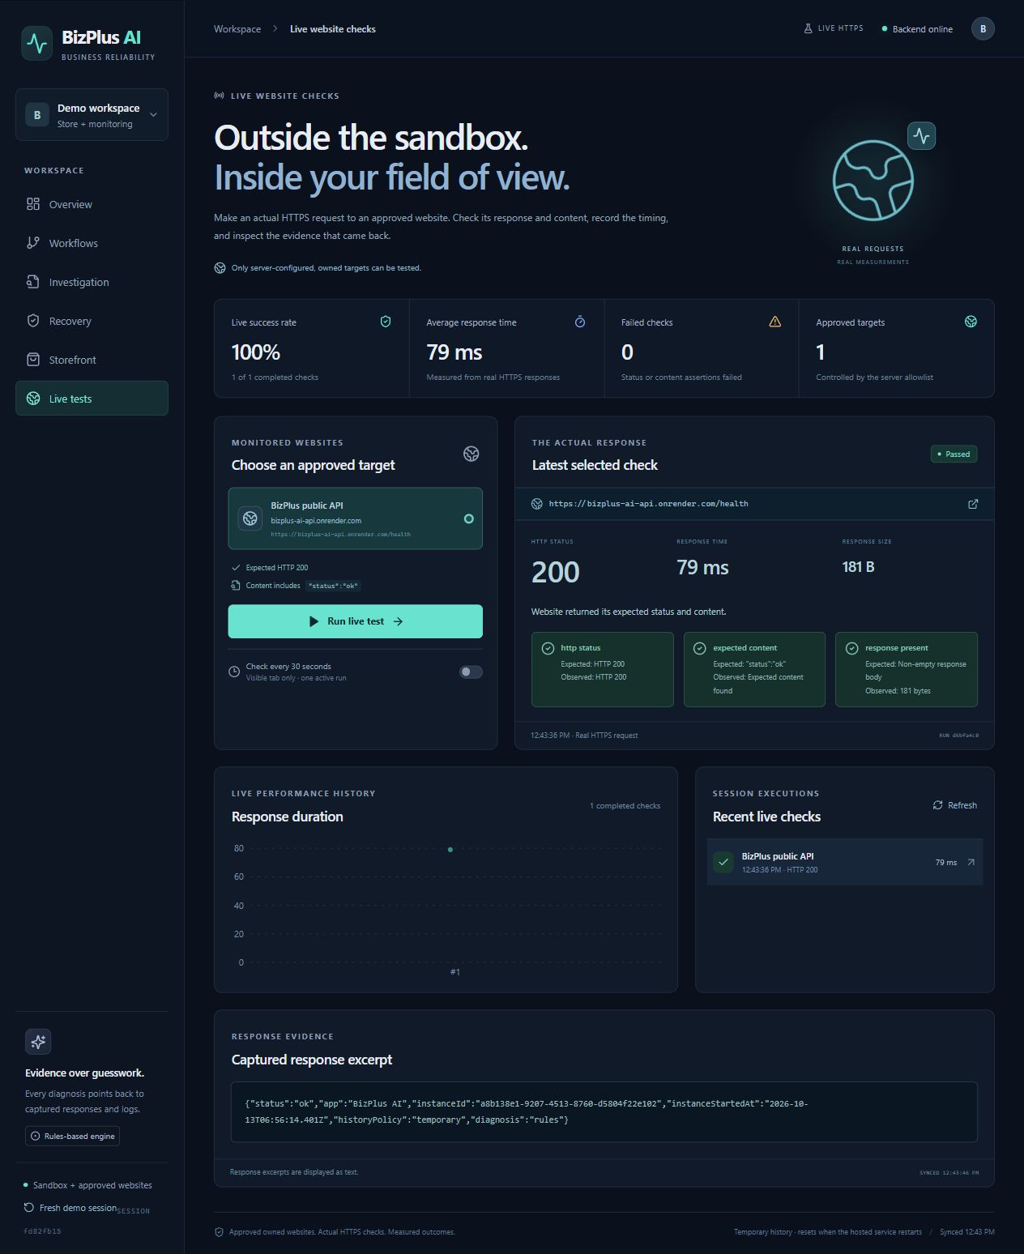
Approved live HTTPS checks
Read-only requests to
approved owned targets
Status and content assertions
Actual response evidence
Public browser sample 79 ms. Earlier wake-up returned HTTP 503.
BizPlus AI 5/7
Notes:
The image shows an actual public Render frontend browser-triggered check of the owned /health endpoint. It passed three assertions with HTTP 200, 79 ms, and 181 bytes. This is one observed warm-service sample, not a benchmark or availability guarantee. An earlier wake-up recorded HTTP 503 and failed the status/content assertions. The earlier separate API replay observed 215 ms; do not average these samples or mix them with synthetic pacing. The browser selects approved target IDs rather than arbitrary URLs. Source: artifacts/verification/render-live-browser.json and artifacts/verification/live-website-cold-start.json.

Slide 6
Verified scope and measured evidence
Verification scope | Observed result
Expanded local automated suite | 33 / 33 passed
Hosted synthetic core HTTP smoke | 18 / 18 passed
Public Razorpay Test purchase | INR 599 captured and verified
Public approved HTTPS sample | HTTP 200 in 79 ms
PostgreSQL adapter | Actual local instance tested
Hosted sandbox samples: healthy 1834 ms, recovery 237 ms
Synthetic requests include a 220 ms demo delay. Samples are not benchmarks.
BizPlus AI 6/7
Notes:
Expanded local automated suite: 33/33. Latest hosted synthetic core HTTP smoke: 18/18. These are separate scopes; the local automated suite was not rerun against Render. The public Razorpay Test Mode purchase of INR 599 is a separate browser/provider verification, and the 79 ms live HTTPS check is another sample. Hosted synthetic healthy sample 1834 ms and recovery verification sample 237 ms include intentional 220 ms sandbox pacing. One simulated payment remained before/after. Local actual Windows PostgreSQL 18 adapter tests passed but hosted Supabase remains unverified. Do not publish total hosted replay elapsed/completedAt because those metadata conflict with later response timestamps. Sources are the respective JSON files in artifacts/verification.

Slide 7
Public demo and next release
Available now | Next release
Business assertions and approved recovery | Authenticated operators and action audit
Public Razorpay Test Checkout | Production payment readiness review
Approved read-only HTTPS monitoring | More validated owned journeys
Temporary SQLite on Render | Activate and verify durable PostgreSQL
Public Render dashboard
https://bizplus-ai-api.onrender.com
Rules-based diagnosis. Active SQLite. Supabase cloud activation pending.
BizPlus AI 7/7
Notes:
The full app is public on Render at https://bizplus-ai-api.onrender.com. /shop uses real Razorpay Test Checkout and /live-tests uses approved owned HTTPS endpoints. Active hosted data remains temporary SQLite. A receipt surviving refresh does not establish durability across sleep, restart, or redeploy. Hosted Supabase activation awaits a valid PostgreSQL connection URI, not the HTTPS project API URL. Add authenticated operators and an audited action policy before production operations. Evaluate optional LLM summaries only against captured evidence. A physical second-device network test remains unverified. Render filesystem source: https://render.com/docs/free . Supabase connection guidance: https://supabase.com/docs/guides/database/connecting-to-postgres .

